Slide 1

ECE 281 Lesson 21
1

Slide 2
Lesson 21 Outline
Do Time Logs!
Lab2 Notebook Due @ 2359 Today
Sequential Building Blocks
Counters
Shift Registers
Memory
RAM
ROM

Slide 3
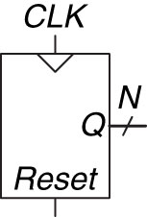
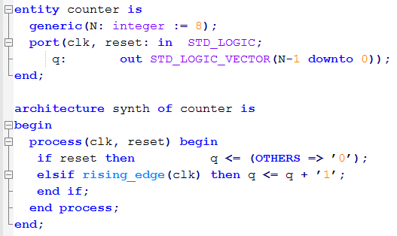
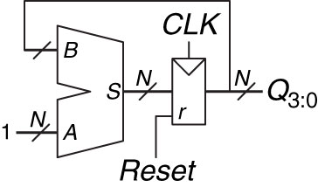
N-Bit Counter

Slide 4
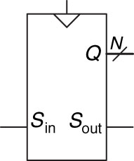
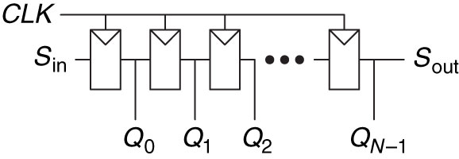
Shift Register Schematic
Serial to parallel conversion
Data shifted into registers on rising clock
Once all data in place, you can read the parallel out

Slide 5
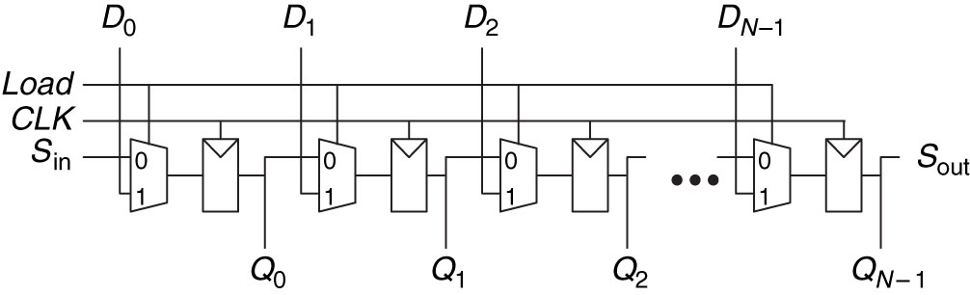
Shift Register with Parallel Load
Parallel to serial
Load -> high
Mux feeds parallel data to registers
Load -> low
Data is shifted out

Slide 6
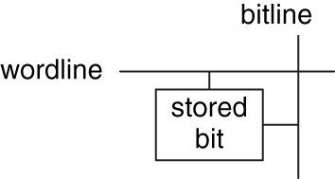
Memory
Address – Indicates which row of memory is read/written (location) 2^{N} (N-Bits)
Data – Value read/written M-Bits
Word – size of a row of data (M-Bits)
Depth – Number of rows
Width – Number of Columns
Wordline – Assert based on address to activate bit cells in a row
Bitline – kept at Z; when wordline is activated
Driven to 1 or 0 by bit cell to read
When written, drives bit cell high or low
Port – Gives read/write access to the address; multi-ported can read/write several addresses at the same time

Slide 7
Memory
Registers of Flip-Flops can store small amounts of data
Memory arrays can store large amounts of data
Memory reads/writes contents of one row of the array
(read or write)
(Address a row)

Slide 8
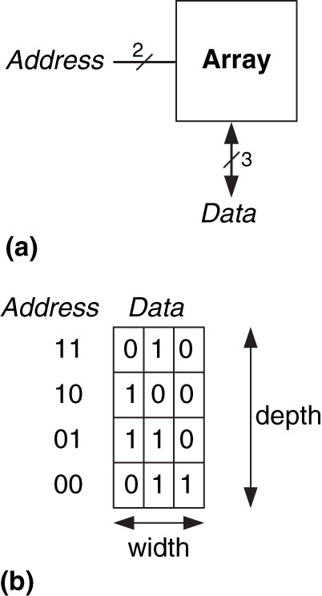
3-Bit Memory Array
(in)
(out)
Width – how many bits in data … a data bus is 10 bits wide
Depth – how much data can you store?

Slide 9
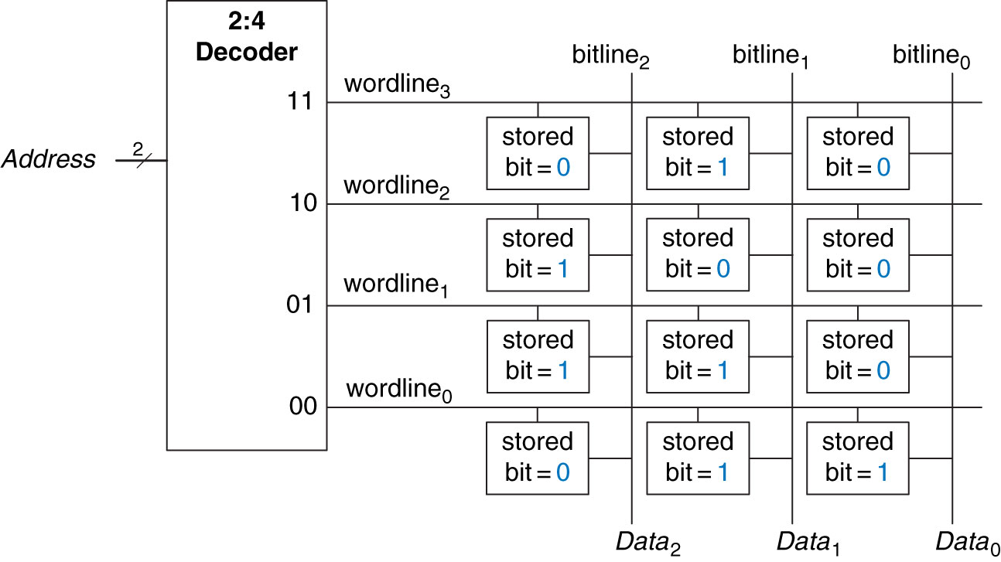
4x3 Memory Array
(rows x columns)

Slide 10
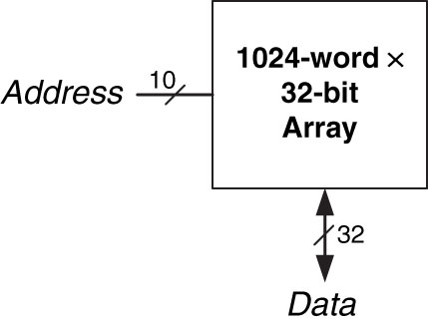
32 Kb Array
1024 words of size 32b inside this memory
(in)
(out)
32 Kb array: depth = 2¹⁰ = 1024 words, width = 32 bits

Slide 11
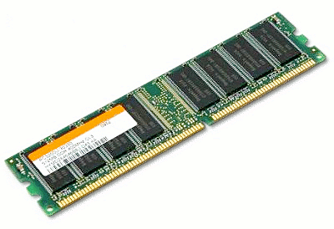
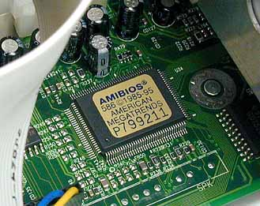
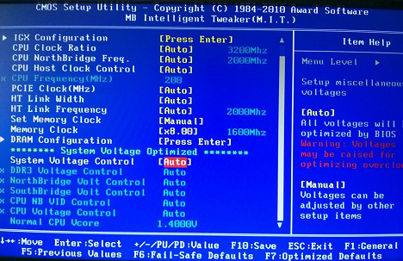
Types of Memory
Types of memory:
RAM –
Random Access Memory
Delay same for all addresses, vs sequential (e.g. type)
Volatile – Loses its data when the power is lost
ROM –
Read Only Memory
Also randomly accessed
Some are re-writable
Non-Volatile

Slide 12
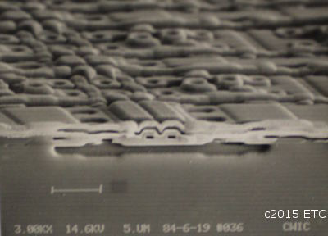
Types of RAM
DRAM – Dynamic RAM
Bit stored as absence or presence of charge on a capacitor
Reading destroys data; must be rewritten
Must be refreshed every few miliseconds due to leaking charge

Slide 13
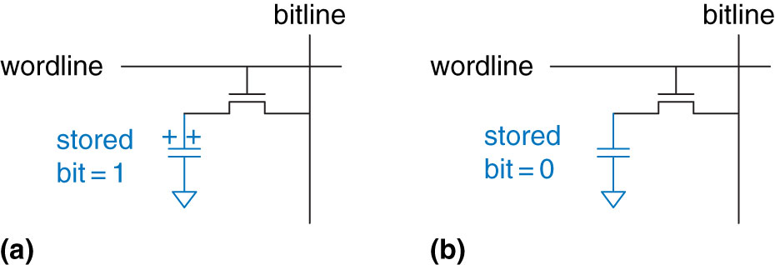
DRAM Stored Values
Capacitors store 1 as charge or 0 as absence of charge
Once read, needs to be refreshed
Capacitor leakage leads to constant refreshing even if not read
transistor

Slide 14
Types of DRAM
DRAM – Dynamic RAM
Bit stored as absence or presence of charge on a capacitor
Reading destroys data; must be rewritten
Must be refreshed every few miliseconds due to leaking charge
SDRAM – Synchronous DRAM
Uses pipelined memory access
DDR SDRAM – Double data rate SDRAM
Uses Rising and falling edge to access data

Slide 15
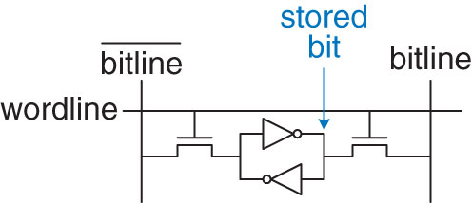
Types of RAM
SRAM – Static RAM
Does not need refreshing
Bit stored in cross coupled inverters
Inverters can restore value if noise interferes

Slide 16
Types of RAM
Larger memories tend to be slower
More transistors = more size, power, and cost
Best Memory depends on speed, cost, power constraints
Memory Type | Transistors per bit cell | Latency
Flip-Flop
SRAM
DRAM
Memory Type | Transistors per bit cell | Latency
Flip-Flop | ~20 | Fast
SRAM | 6 | Medium
DRAM | 1 | Slow

Slide 17
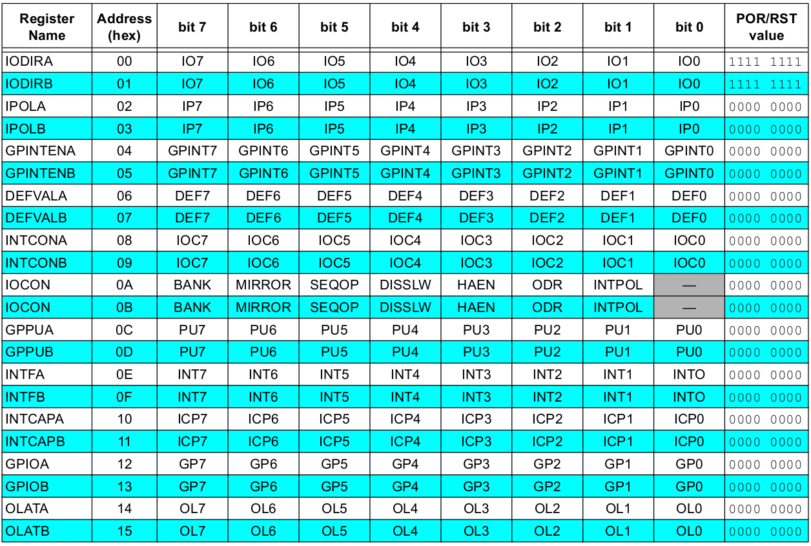
Raspberry Pi Register Map

Slide 18
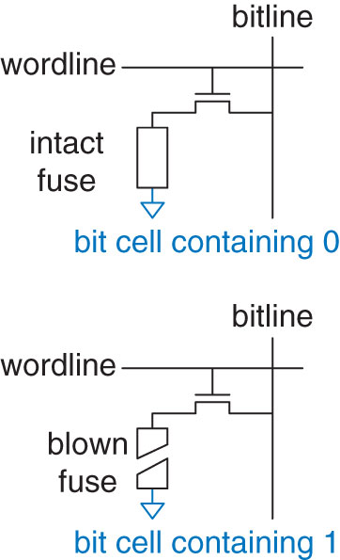
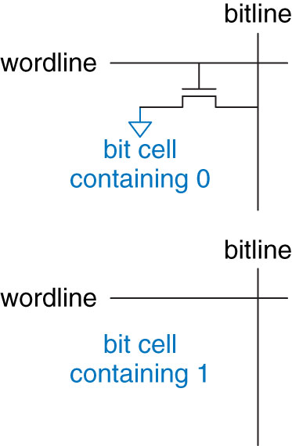
ROM Bit Cells
Programmable ROM – Provides a way to connect transistor with ground
A way to implement, until you blow the fuse, you can read/write

Slide 19
Types of ROM
PROM – Programmable Read Only Memory – Provides a way to connect transistor with ground
Fuse Programmable ROM – blow fuse = 1, cannot be rewritten
EPROM – Eraseable PROM
High voltage to write
UV light to erase
EEPROM – Electrically EPROM
Bit cells individually erased
Erased without UV light with extra circuitry
Flash – Large blocks erased
Cheaper because less erasing circuitry

Slide 20
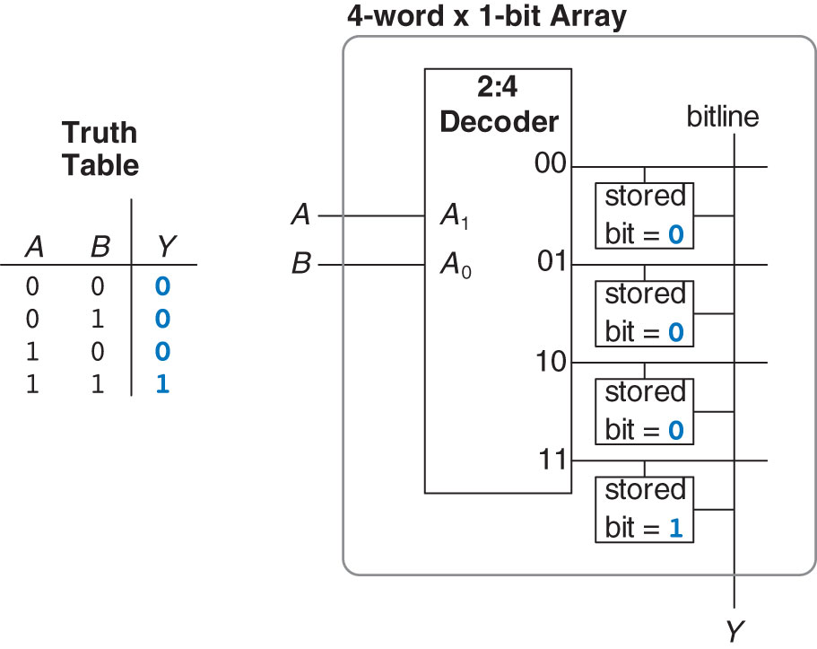
4-Word – 1-Bit memory array used as lookup table
Figure 5.52 4-word  1-bit memory array used as a lookup table
Copyright © 2013 Elsevier Inc. All rights reserved.

Slide 21
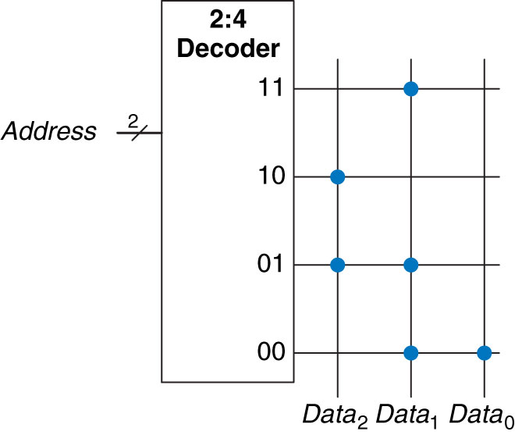
3 ROM Dot Notation
Figure 5.49 4  3 ROM: dot notation
Copyright © 2013 Elsevier Inc. All rights reserved.

Slide 22
3 ROM Dot Notation
Figure 5.49 4  3 ROM: dot notation
Copyright © 2013 Elsevier Inc. All rights reserved.

Slide 23
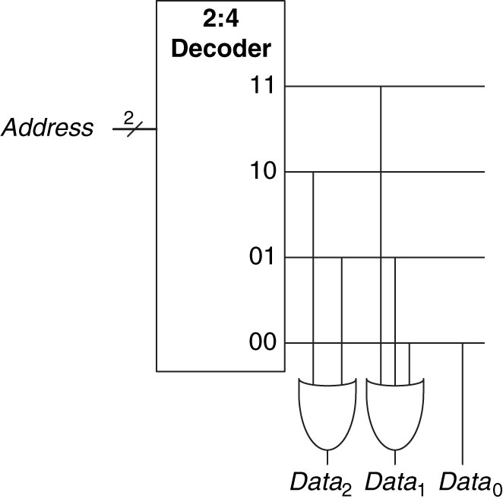
3 ROM Dot Notation – using gates
Figure 5.50 4  3 ROM implementation using gates
Copyright © 2013 Elsevier Inc. All rights reserved.

Slide 24
Practice
5.43: Build a 32-Bit Synchronous Up/Down Counter
Inputs: Reset, Up = 1 (i.e. Up)

Slide 25

25

Slide 26
Types of ROM
PROM – Programmable Read Only Memory – Provides a way to connect transistor with ground
Fuse Programmable ROM – blow fuse = 1, cannot be rewritten
EPROM – Eraseable PROM
High voltage to write
UV light to erase
EEPROM – Electrically EPROM
Bit cells individually erased
Erased without UV light with extra circuitry
Flash – Large blocks erased
Cheaper because less erasing circuitry

Slide 27
Fuse-Programmable ROM Bit Cell
Figure 5.51 Fuse-programmable ROM bit cell
Copyright © 2013 Elsevier Inc. All rights reserved.

Slide 28
Counter Symbol
Figure 5.30 Counter symbol
Copyright © 2013 Elsevier Inc. All rights reserved.

Slide 29
Shift Register Symbol
Figure 5.33 Shift register symbol
Copyright © 2013 Elsevier Inc. All rights reserved.

Slide 30
Shift Register with Parallel Load
What is the difference between a Shifter and a Shift Register?
A shifter is purely combinational logic

Slide 31
Sequential Building Blocks
What is the Difference between Sequential and Combinational Logic Circuits?
Sequential has memory (i.e. Flip-Flops)

Slide 32
Bit Cell
Figure 5.41 Bit cell
Copyright © 2013 Elsevier Inc. All rights reserved.

Slide 33
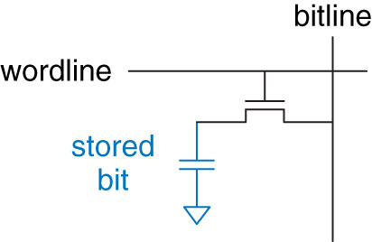
DRAM Bit Cell
Figure 5.44 DRAM bit cell
Copyright © 2013 Elsevier Inc. All rights reserved.

Slide 34
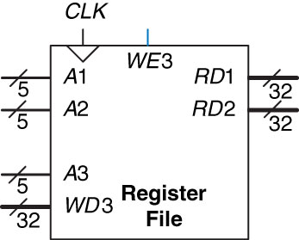
Register File
Register File – Group of registers that stores temporary variables
Often consists of small multiported SRAM
Figure 5.47 32  32 register file with two read ports and one write port
Copyright © 2013 Elsevier Inc. All rights reserved.

Slide 35
SRAM Bit Cell
Figure 5.46 SRAM bit cell
Copyright © 2013 Elsevier Inc. All rights reserved.

